Slide 1
Getting Started with Azure IoT Edge (v2)
Bret Stateham
Bret.Stateham@Microsoft.com

Slide 2
Agenda
IoT Edge Overview
Configuring IoT Edge
Creating Custom Modules
Use Cases
& Wrap UP

Slide 3
Azure IoT Edge Overview

Slide 4
Azure IoT Hubs
Devices in the Field MCUs, Actuators, Sensors
Microsoft Azure Services
Compute, DBs, AI, BI, etc.
Standard Protocols AMQPS MQTTS HTTPS
Open APIs and SDKs

Slide 5
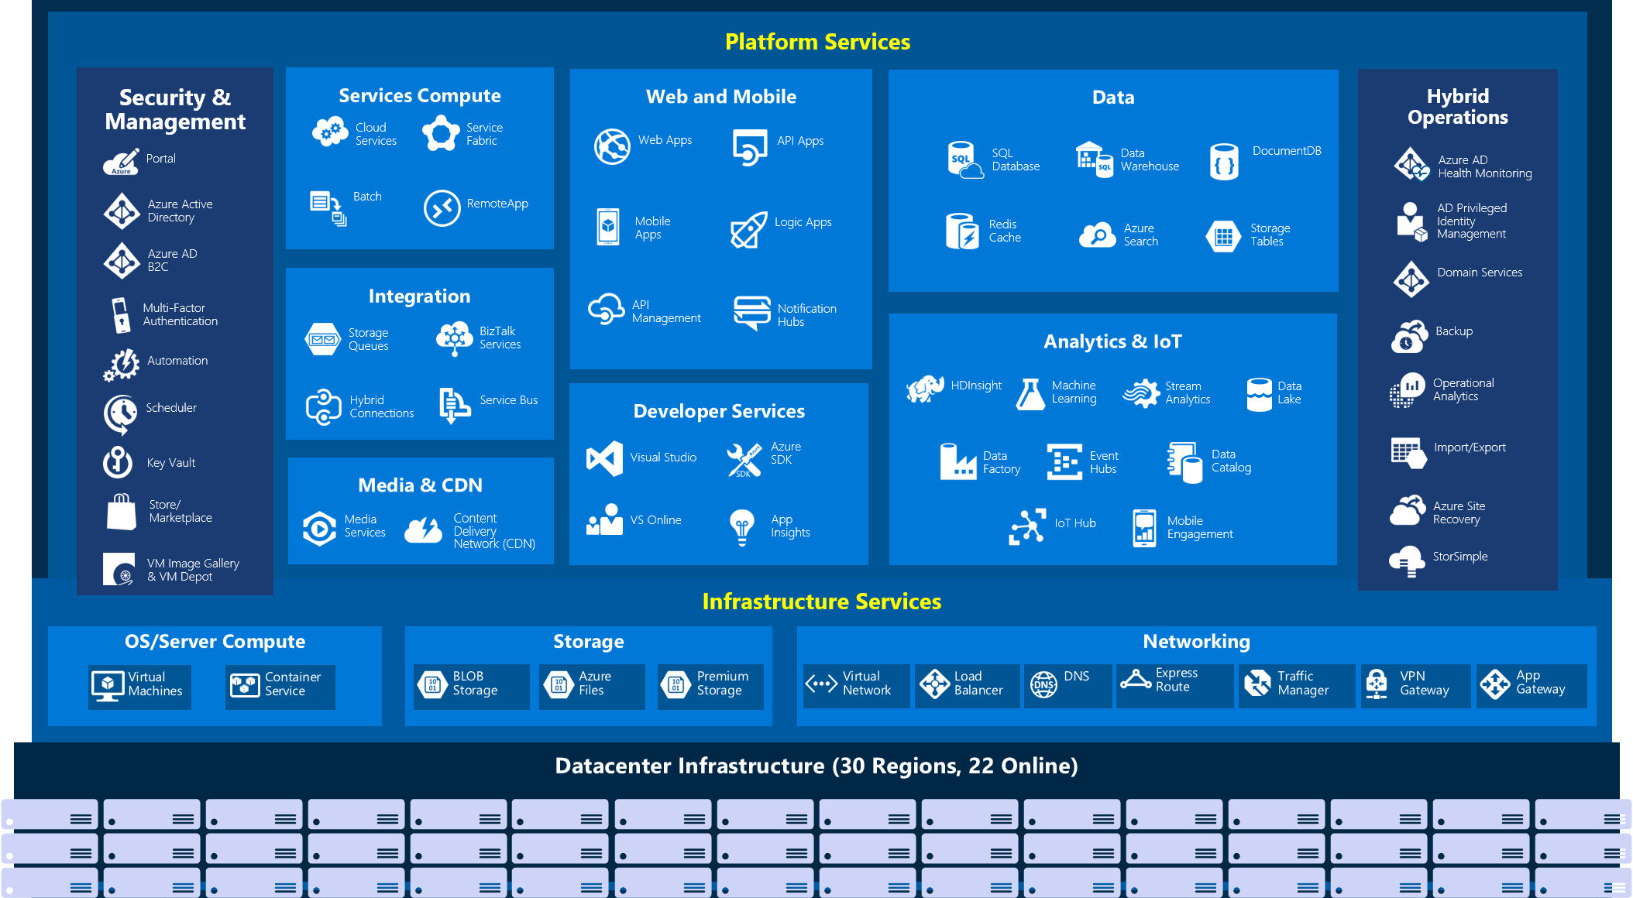

Slide 6
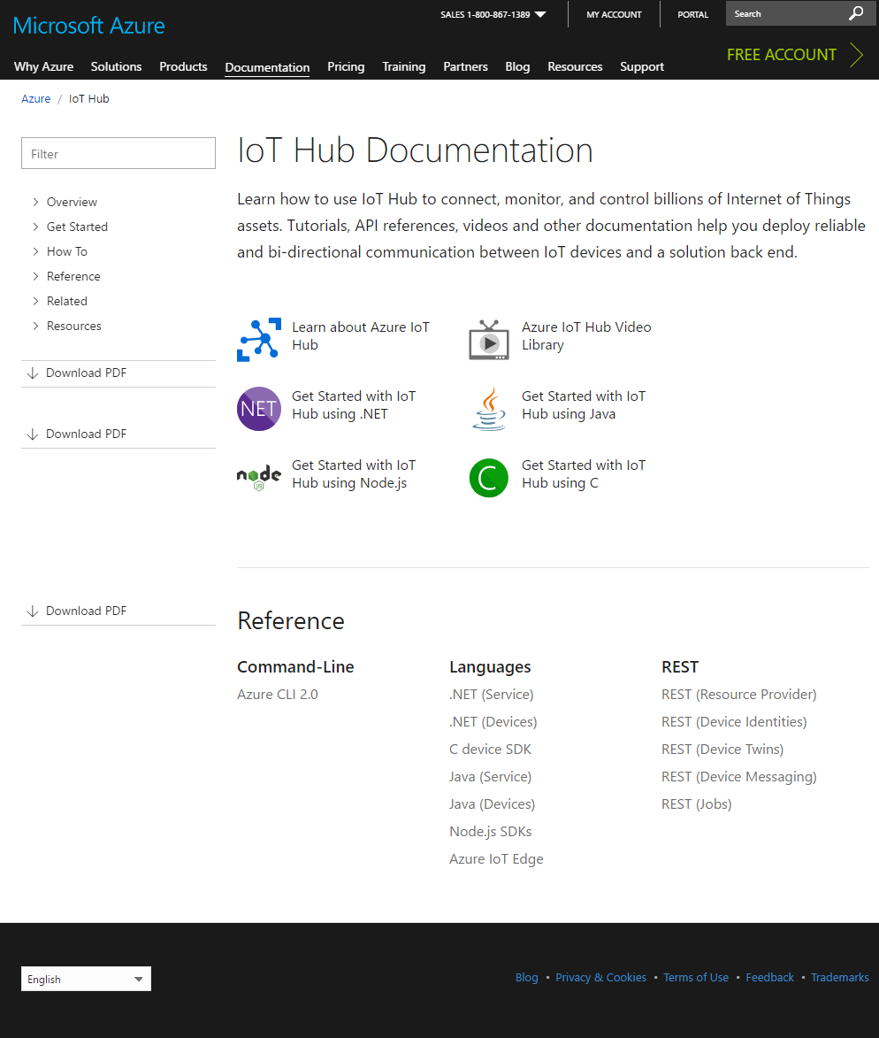
Get the Docs
https://docs.microsoft.com/en-us/azure/iot-hub/

Slide 7
Create an IoT Hub

Slide 8

NOT EVERY DEVICE CAN CONNECT TO THE INTERNET

Slide 9
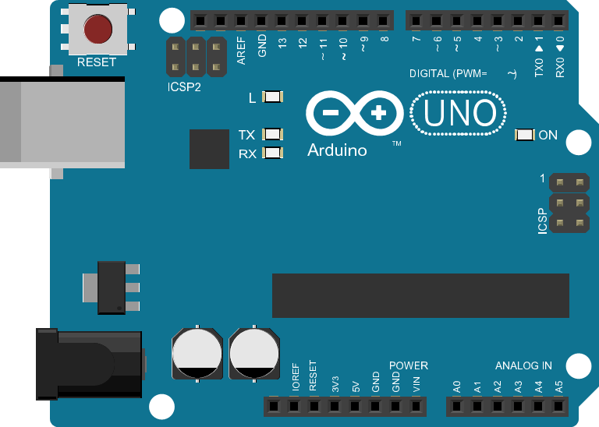
NOT EVERY DEVICE CAN DO TLS/SSL

Slide 10
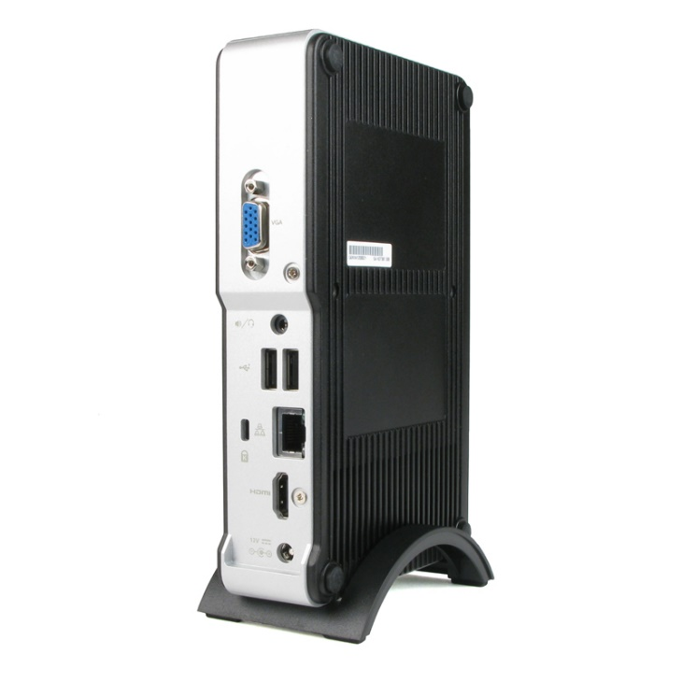
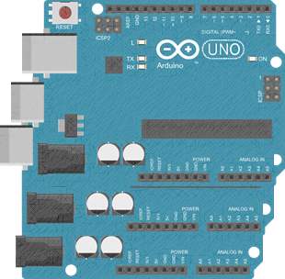
Field Gateways to the rescue…
Devices
Field Gateway
IoT Hub
USB, BLE, RF, Serial, WiFi….
AMQPS, MQTTS, HTTPS

Slide 11
Field Gateways to the rescue…
Devices
Field Gateway
IoT Hub
USB, BLE, RF, Serial, WiFi….
AMQPS, MQTTS, HTTPS

Slide 12
What code runs on the gateway?
Azure IoT Edge

Slide 13
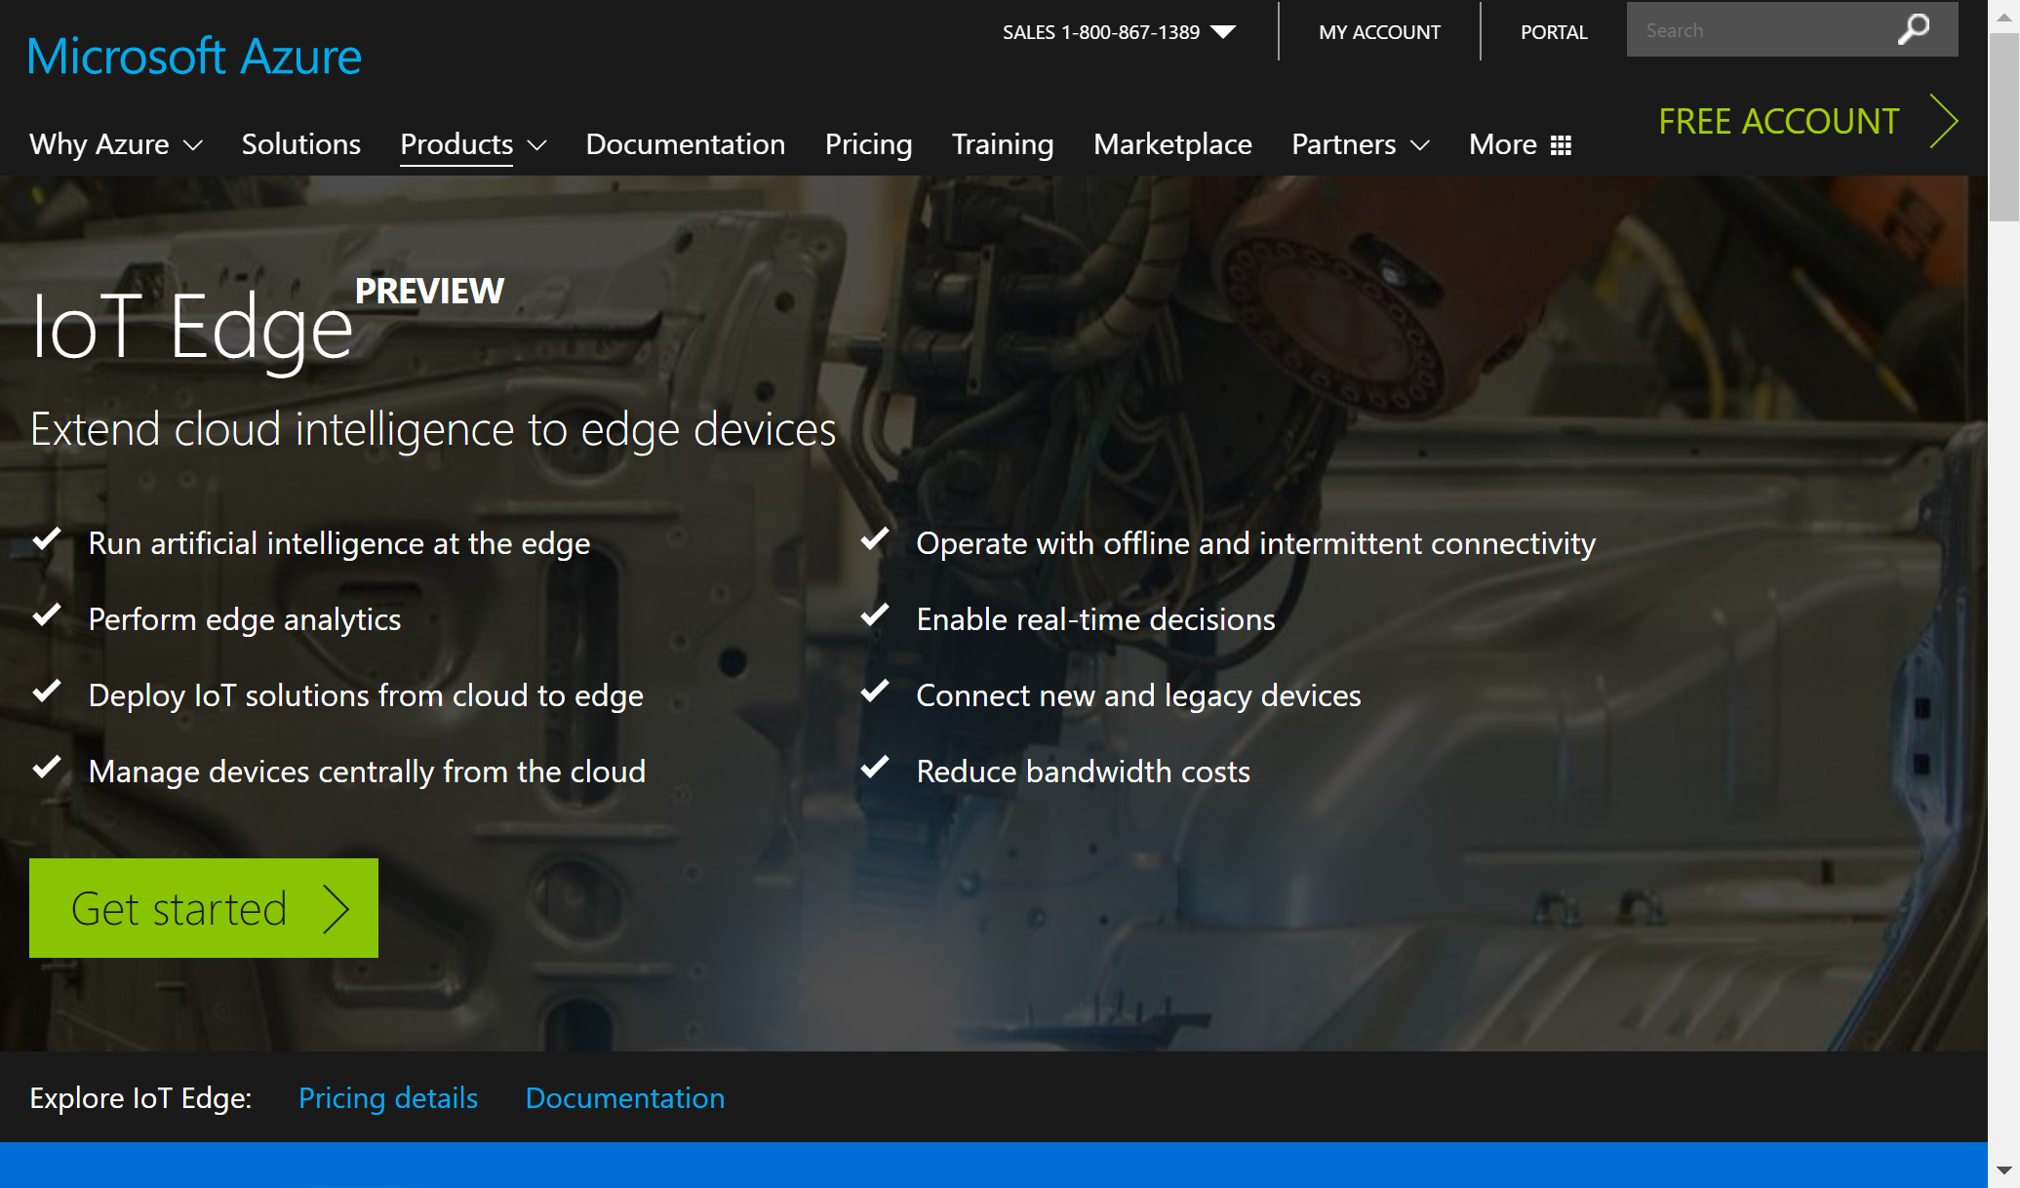

Slide 14
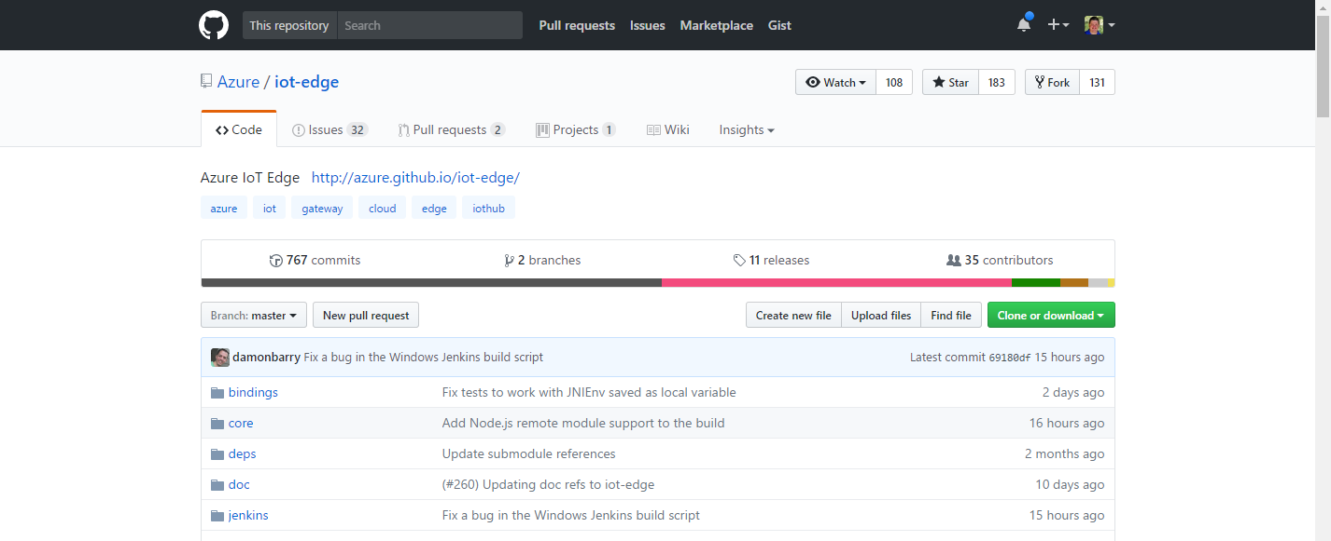
Azure IoT Edge is Open source in GitHub
https://github.com/Azure/iot-edge
ONLY V1 RIGHT NOW. V2 WILL OPEN SOURCE AFTER RELEASE

Slide 15
Major changes from V1
Modules are docker containers, pulled from the cloud
Modules can be written in C#, F#, Python, Node.js
Not all language implemented yet in preview, demos in C#
Allows updating the gateway from the cloud
All messaging is done using an IoT Hub compatible api
Modules communicate with the gateway as if they were devices and the gateway was a hub
Modules have twins that can be configured in the cloud
The gateway itself acts as a device that also has a twin
Lots of goodness

Slide 16
Configuring Azure IoT Edge

Slide 17

You will need docker…

Slide 18
System Modules & $Upstream…
edgeAgent Represents the gateway device id. Pulls new configs, contgainers, etc.
edgeHub Manages the communication between modules
MODULES
IoT Hub Compatible Messae Broker
ROUTES
$upstream

Slide 19
Configure Azure IoT Edge

Slide 20
Simulated Temp Module…
edgeAgent Represents the gateway device id. Pulls new configs, contgainers, etc.
edgeHub Manages the communication between modules
tempSensor Generates sample sensor data
https://github.com/Azure/iot-edge/tree/master/v2/samples/azureiotedge-simulated-temperature-sensor
MODULES
microsoft/azureiotedge-simulated-temperature-sensor:1.0-preview
IoT Hub
temperatureOutput
IoT Hub Compatible Messae Broker
ROUTES
FROM /* INTO $upstream

Slide 21
Simulated Temperature Module

Slide 22
Creating Custom Modules

Slide 23
Custom C# Filter Module…
edgeAgent Represents the gateway device id. Pulls new configs, contgainers, etc.
edgeHub Manages the communication between modules
tempSensor Generates sample sensor data
filterModule Only forwards messages with a machine temp over threshold
MODULES
IoT Hub
temperatureOutput
input1
IoT Hub Compatible Messae Broker
output1
ROUTES
$upstream

Slide 24
Custom C# Filter Module

Slide 25
Use Cases & Wrap Up

Slide 26
Automotive Data to Azure
Azure IoT Edge
ECU
TEMP
RPM
/ OBD-II
CAN
ECU
THROTTLE

Slide 27
Automotive Data to Azure
Azure IoT Edge
ECU
TEMP
RPM
/ OBD-II
CAN
ECU
THROTTLE

Slide 28
The Car is the Bottleneck
Azure IoT Edge
ECU
TEMP
RPM
/ OBD-II
CAN
ECU
THROTTLE

Slide 29
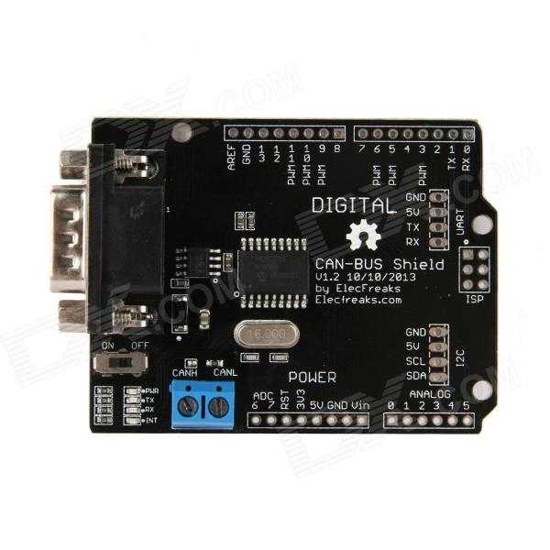
Arduino Based ECU Simulator
Azure IoT Edge
TEMP
RPM
THROTTLE
ETC

Slide 30
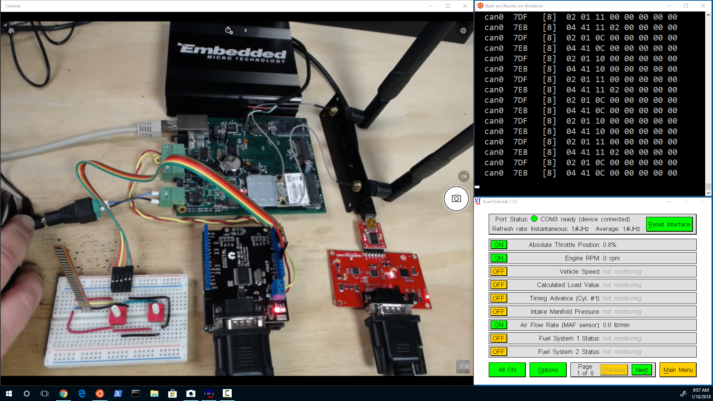

Slide 31
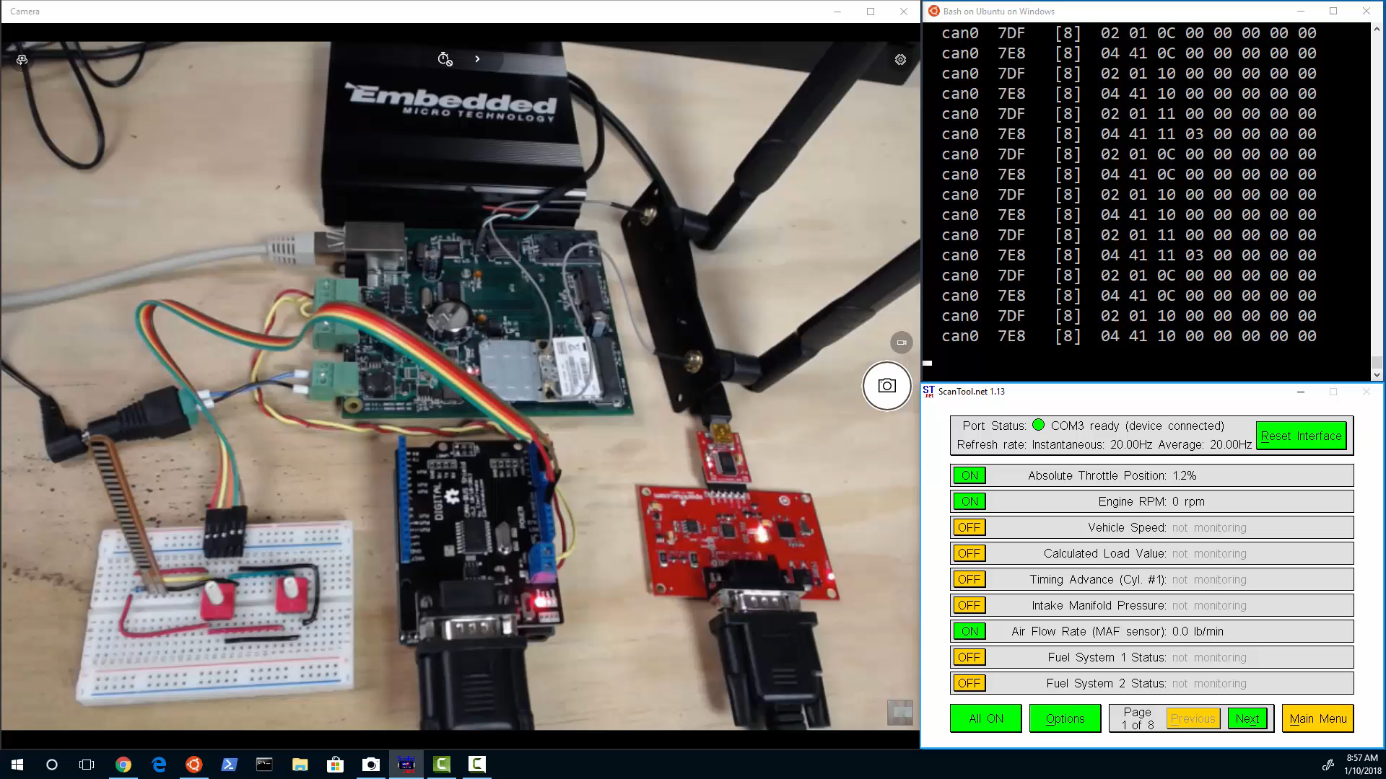

Slide 32
Getting Started with Azure IoT Edge (v2)
Bret Stateham
Bret.Stateham@Microsoft.com

